Slide 1

Banking Data Analysis Using EDA and Power BI
A Capstone Project
Presented By
Shreyash Vishwakarma
© All rights reserved by Fireblaze Technologies Pvt. Ltd.

Slide 2
Problem Statement
In today's competitive banking landscape, understanding customer behavior is more critical than ever. Our goal was to dive deep into a comprehensive banking dataset to uncover meaningful patterns and trends. We aimed to move beyond just raw numbers and transform complex data into a clear story, using Exploratory Data Analysis (EDA) in Python and interactive visualizations in Power BI to derive actionable insights that can drive strategic business decisions.
© All rights reserved by Fireblaze Technologies Pvt. Ltd.

Slide 3
About the Data
The foundation of this project was a structured banking dataset, rich with information about customer demographics, loan details, deposit information, and more. To ensure our analysis was always based on the most current information, we established a direct, live connection from a SQL Server database to Power BI. This approach not only allowed for seamless data flow but also ensured our insights were timely and relevant.
© All rights reserved by Fireblaze Technologies Pvt. Ltd.

Slide 4
Proposed Solution
We adopted a multi-stage approach to tackle this analysis, creating a robust pipeline from raw data to insightful reporting
Data Foundation (SQL Server): We started by housing our data in a secure and efficient SQL Server database, providing a stable backend for our analysis.
2. Data Cleaning & Exploration (Python): Next, we used Python's powerful data science libraries (like Pandas, Matplotlib, and Seaborn) to clean and prepare the data.
3. Interactive Reporting (Power BI): Finally, we connected our cleaned data to Power BI to build a dynamic and interactive dashboard for compelling visual reports.
Slide 4 of 6
© All rights reserved by Fireblaze Technologies Pvt. Ltd.

Slide 5
Proposed Solution
2. Data Cleaning & Exploration (Python): Next, we used Python's powerful data science libraries (like Pandas, Matplotlib, and Seaborn) to clean and prepare the data.
3. Interactive Reporting (Power BI): Finally, we connected our cleaned data to Power BI to build a dynamic and interactive dashboard for compelling visual reports.
© All rights reserved by Fireblaze Technologies Pvt. Ltd.

Slide 6
Conclusion & Key Insights
Our integrated analysis revealed several key insights that provide significant business value:
Customer Demographics Matter: Males contribute slightly more to loans and deposits, and professionals like Professors and Engineers are highly active customers.
© All rights reserved by Fireblaze Technologies Pvt. Ltd.

Slide 7
Conclusion & Key Insights
Income is a Key Driver: High-income customers are the primary drivers of loan volume.
Geographic Trends: Customers from Europe have the highest deposit volumes, suggesting a key market segment.
These insights allow for a more strategic approach to marketing, service improvement, and product development.
© All rights reserved by Fireblaze Technologies Pvt. Ltd.

Slide 8
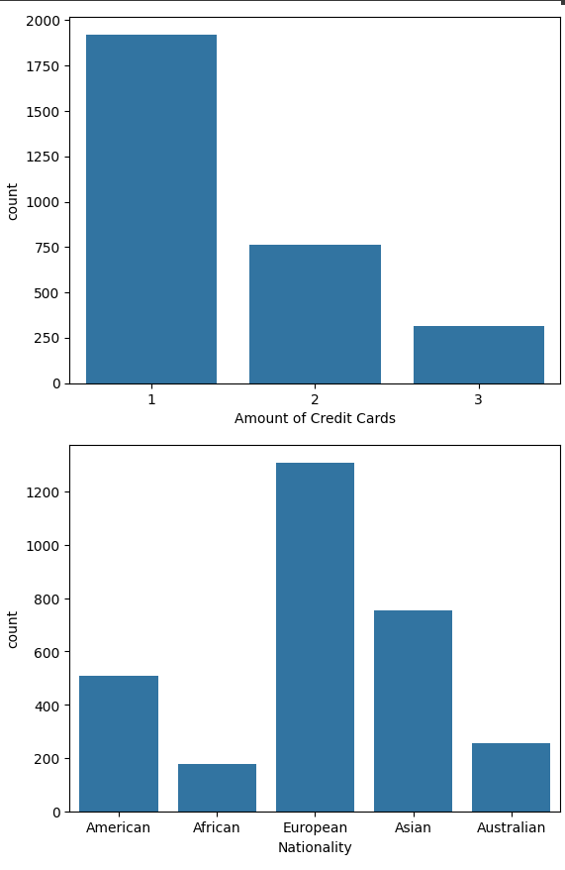
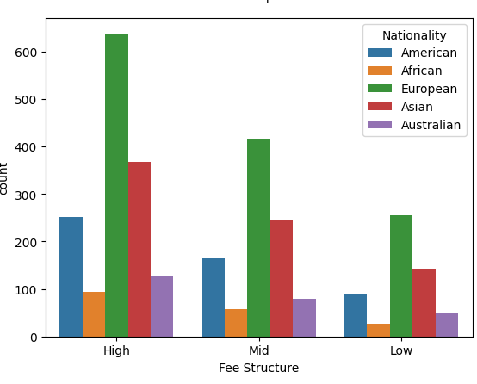
Conclusion & Key Insights (Graphs)
© All rights reserved by Fireblaze Technologies Pvt. Ltd.

Slide 9
Conclusion & Key Insights
FEE STRUCTURE - European Customers Dominate All Fee TiersThis chart breaks down our customer base by nationality within each fee structure (High, Mid, Low).Key Finding: European clients are the largest segment across the board.Europeans are the #1 customer segment in every fee category, especially the high-value "High" tier.Asians and Americans form the second and third largest groups, respectively.Strategic Question: Is our current market focus intentional, or are we missing opportunities to attract high-value customers from other regions | NUMBER OF CREDIT CARDS THEY OWN AND THEIR NATIONALITY. Snapshot of Our Typical Customer These charts profile our customer base by the number of credit cards they own and their nationality. Key Findings: Our core customer has a distinct profile. Nationality: The bank's primary customer is European, with over 1,300 clients from this region. Product Penetration: The vast majority of our clients (nearly 2,000) hold only one credit card. Business Opportunity: There is significant potential to increase credit card revenue by marketing additional card products to our large, existing base of single-card-holding European customers. Sources
© All rights reserved by Fireblaze Technologies Pvt. Ltd.

Slide 10
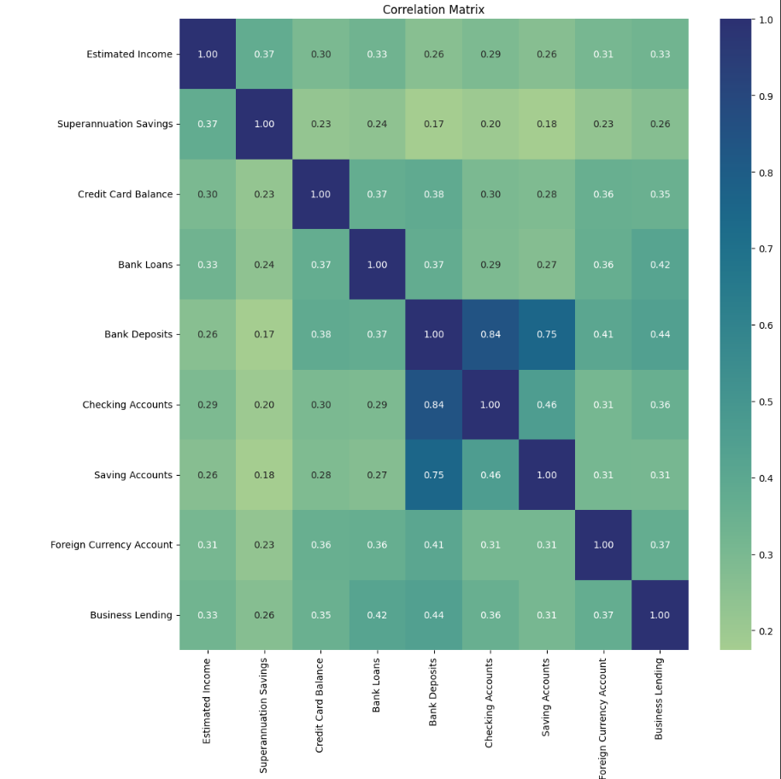
Conclusion & Key Insights (Graphs)
© All rights reserved by Fireblaze Technologies Pvt. Ltd.

Slide 11
Conclusion & Key Insights
Strong Link Between Customer AccountsThis heatmap shows how strongly different financial accounts are related. Darker blue indicates a stronger positive relationship.Key Finding: There is a powerful link between a customer's core accounts.Bank Deposits and Checking Accounts have a very strong positive correlation of 0.84.Bank Deposits and Saving Accounts also show a strong correlation of 0.75.Business Insight: Customers with high deposit balances are prime candidates for cross-selling checking and savings products. Our marketing should emphasize bundled account benefits.
© All rights reserved by Fireblaze Technologies Pvt. Ltd.

Slide 12
Future Scope
This project has laid a strong foundation for future data-driven initiatives. Here are a few potential next steps:
Predictive Modeling: Build models to forecast customer churn or identify potential new product interests.
Deeper Customer Segmentation: Create more granular customer segments for hyper-personalized marketing campaigns.
Real-Time Anomaly Detection: Develop systems to monitor transactions in real-time to enhance security and fraud detection.
© All rights reserved by Fireblaze Technologies Pvt. Ltd.

